Slide 1
Secure Code Analyser Mentor: Mr. Jatin Sethi
Bineek Raja, Vikash Anand, Vandana Sharma, Mohit Pandey
B-Tech Computer Science Engineering with Specialization in BFSI – 6th Semester

Slide 2
Abstract
Secure code analyser, also known as Static Application security testing tool. We use it to find out security flaws. There are many guidelines that a programmer can implement to aid in the prevention of common security bugs in applications which we will follow. There are many guildelines which we can use in all languages but there are also some guidelines that can only work with a specific language. In this secure code Analyser we only work with C , C++ and Java languages . Analysers allow a programmer to remove much of the common vulnerabilities found in code.

Slide 3
Introduction
Secure code analyzer, also referred as Static Application Security Testing (SAST) Tools. It is designed to analyze source code and compiled versions of code to help find security flaws. designed to analyze source code or compiled versions of code. There are many guidelines that a programmer can implement to aid in the prevention of common security bugs in applications. Many of these can be applied to any programming language, but some are specific to only one language. In this project we are mainly working on programming languages like C, C++ and Java. There are numerous guidelines and tips that a programmer can implement to aid in the prevention of common security bugs in applications. Analyzers allow a programmer to remove much of the common vulnerabilities found in code. So with the help of Secure code Analyzer we can find out all the flaws in our programs and remove them.

Slide 4
Objective
To implement a static application that will Analyse the vulnerability of the code in C, C++ and Java.

Slide 5
Problem Statement
To analyse and find vulnerability of our code.
Provide solutions for the vulnerability of the code that is being analysed.

Slide 6
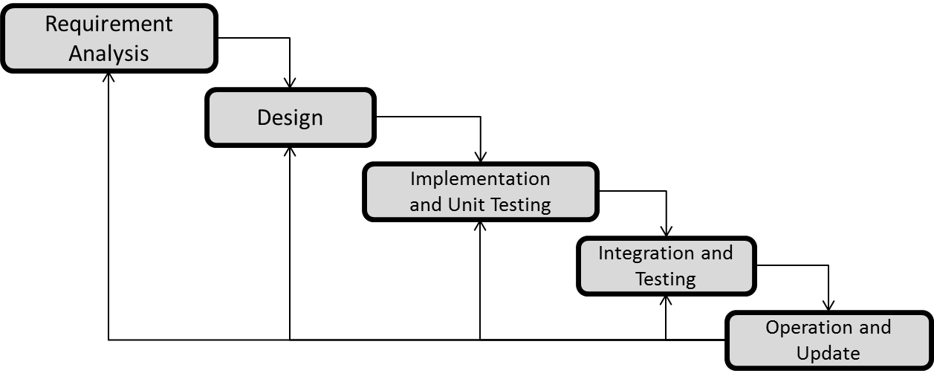
Methodology
We are using ITERATIVE WATERFALL MODEL due to large data size and complexity of our project.

Slide 8
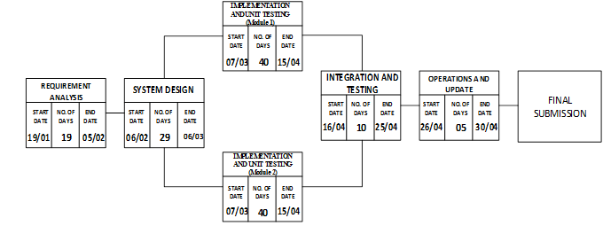
Pert Chart

Slide 9
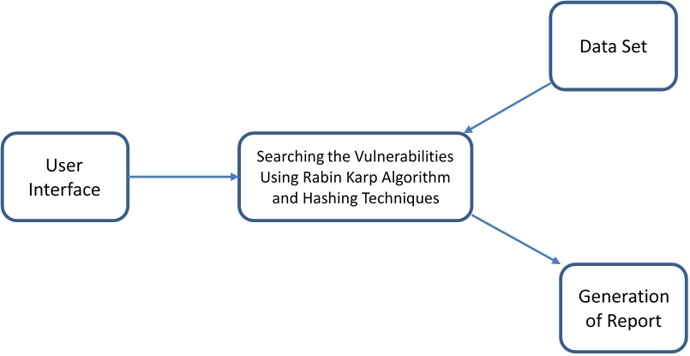
Data Flow Diagram
Level 0 DFD

Slide 10
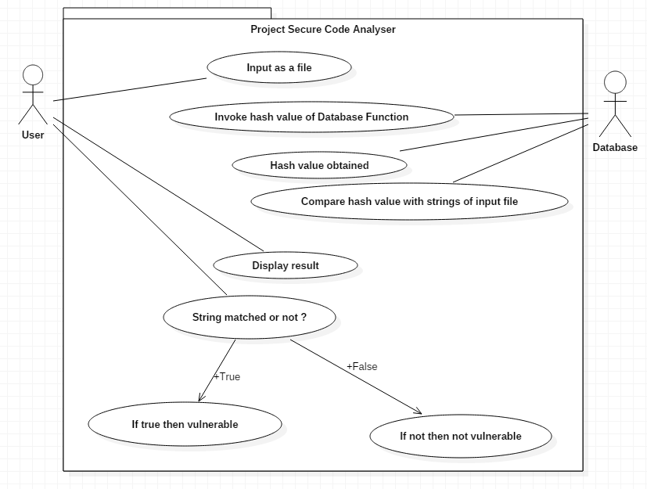
Use Case Diagram

Slide 11
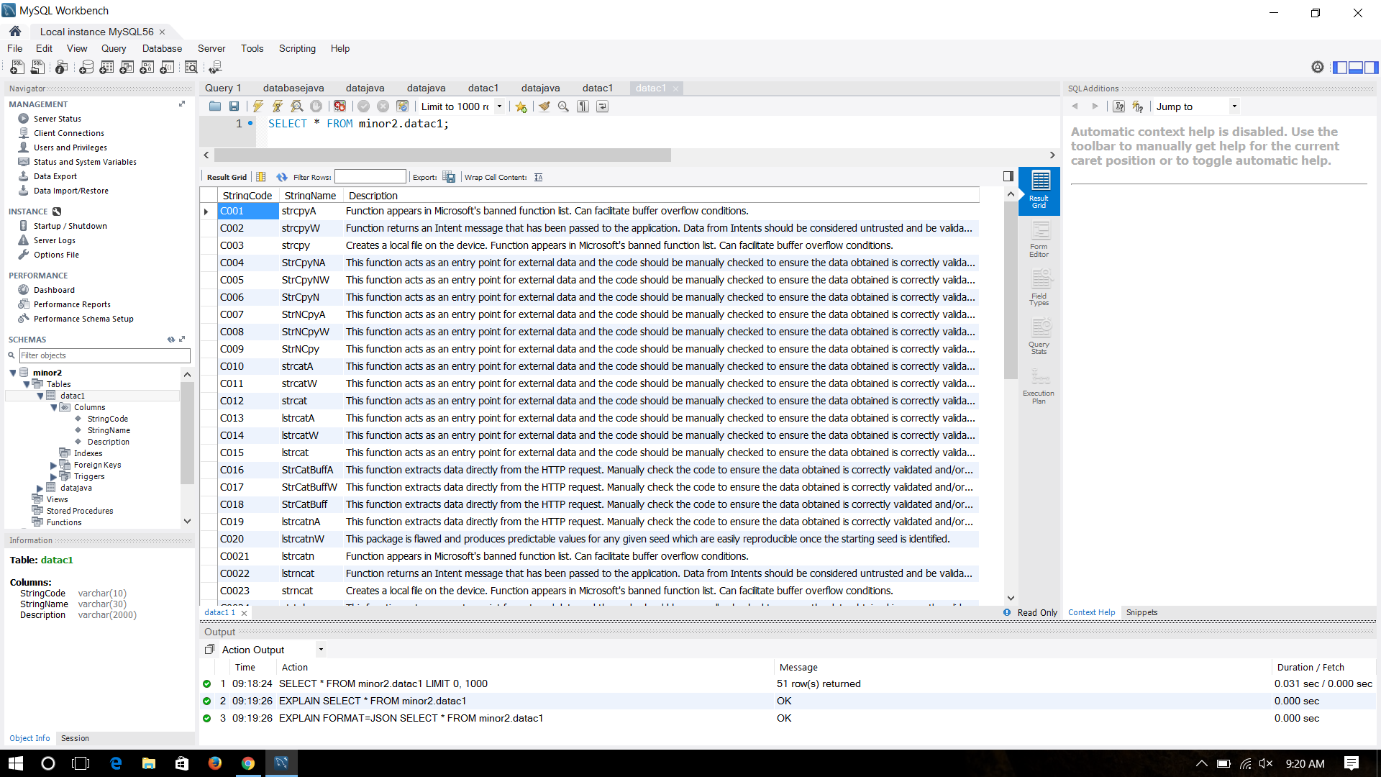
Database

Slide 12
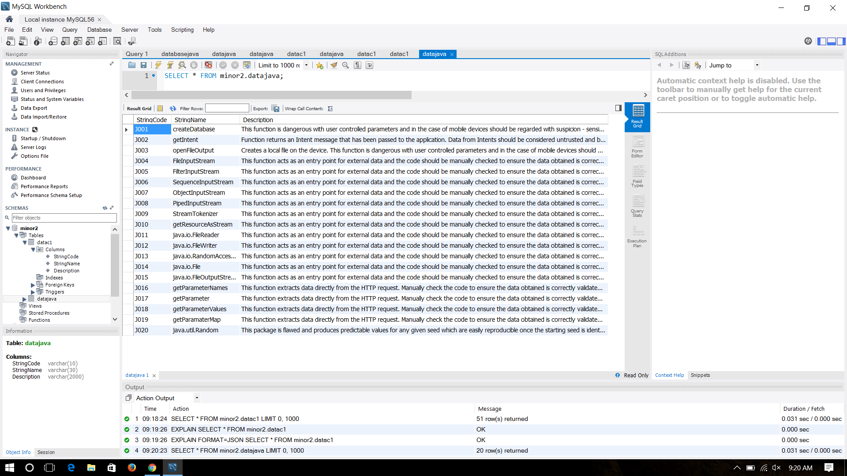
Database

Slide 13
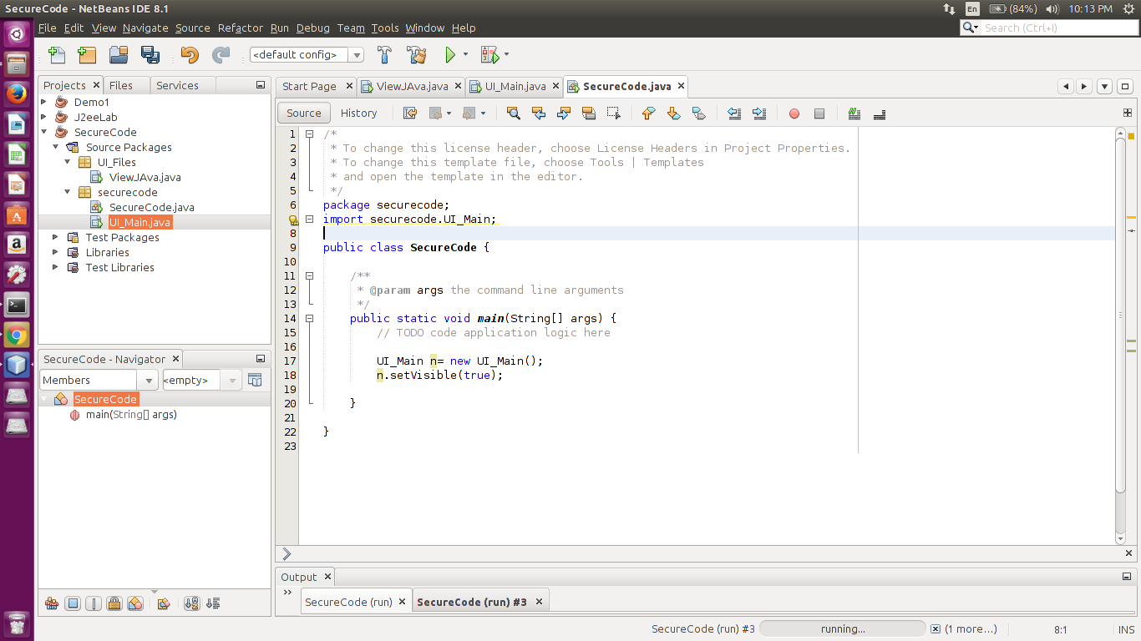
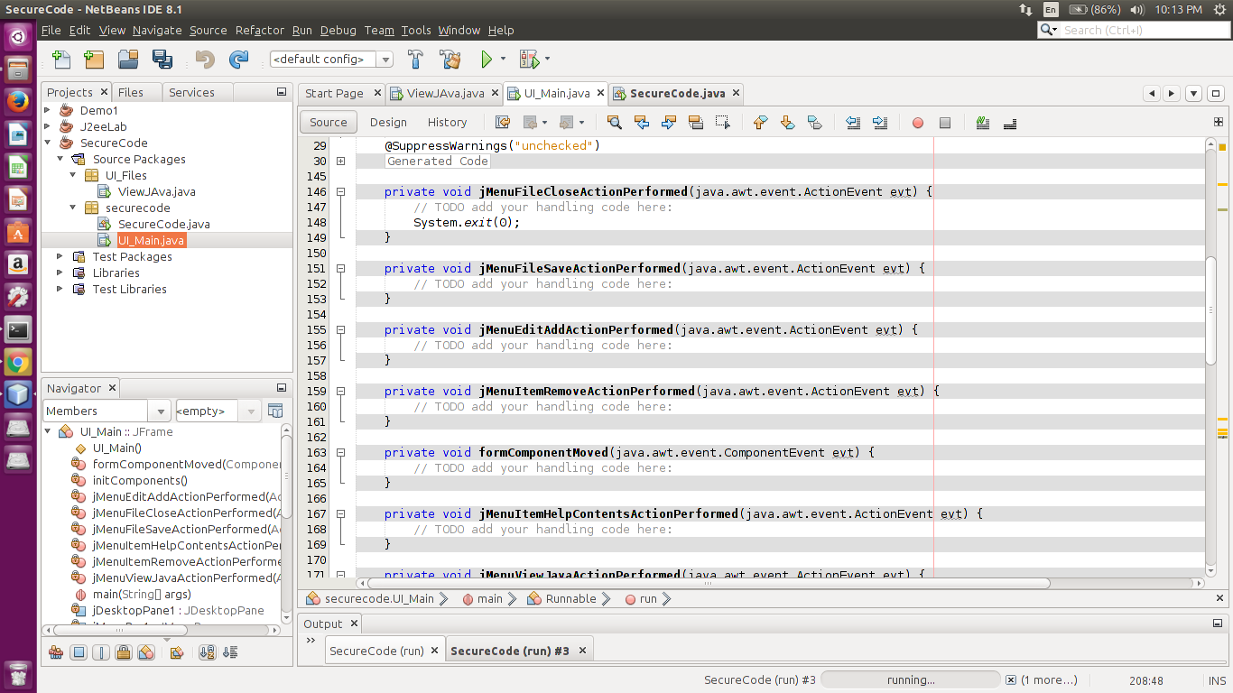
Code (User Interface)

Slide 14
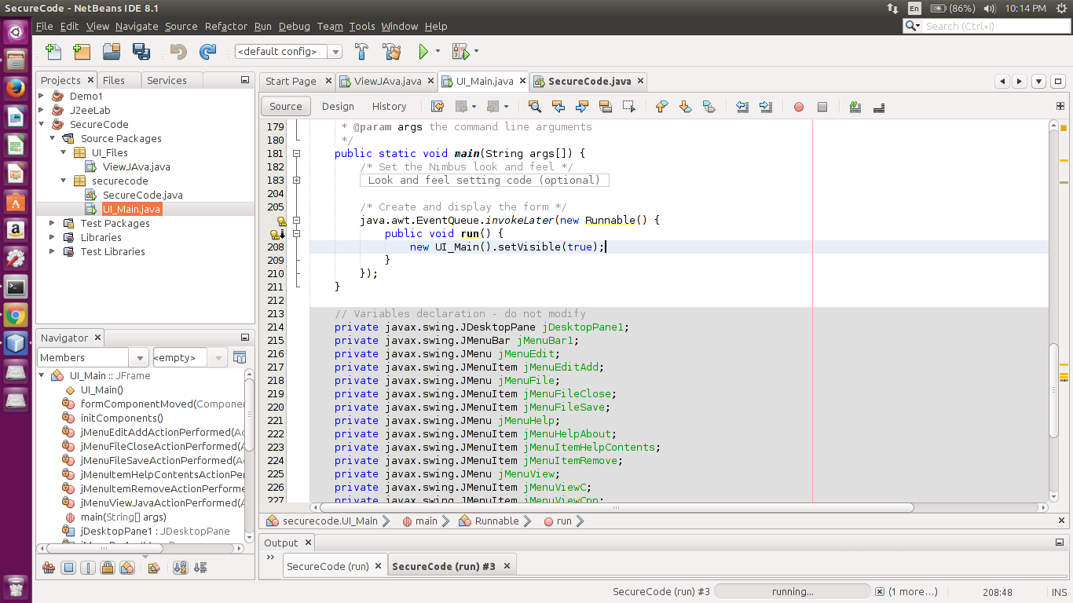
Code (User Interface)

Slide 15
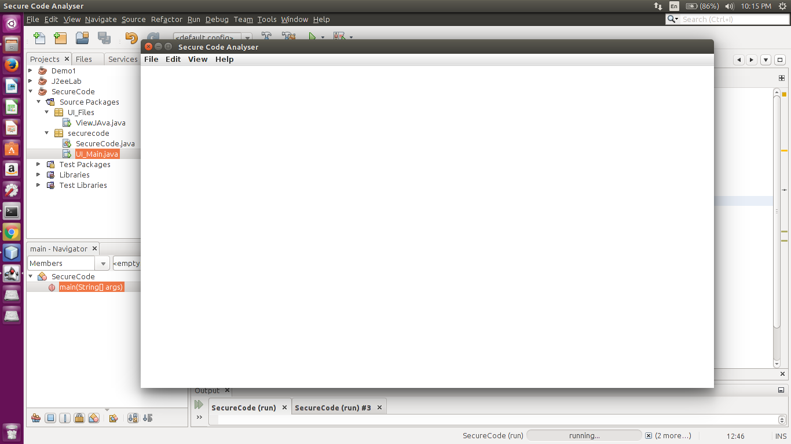
User Interface

Slide 16
Code
public class RabinKarpSearch {
private int prime = 101;
public int patternSearch(char[] text, char[] pattern){
int m = pattern.length;
int n = text.length;
long patternHash = createHash(pattern, m - 1);
long textHash = createHash(text, m - 1);
for (int i = 1; i <= n - m + 1; i++) {
if(patternHash == textHash && checkEqual(text, i - 1, i + m - 2, pattern, 0, m - 1)) {
return i - 1;
}
if(i < n - m + 1) {
textHash = recalculateHash(text, i - 1, i + m - 1, textHash, m);
}
}
return -1;
}
private long recalculateHash(char[] str,int oldIndex, int newIndex,long oldHash, int patternLen) {
long newHash = oldHash - str[oldIndex];
newHash = newHash/prime;
newHash += str[newIndex]*Math.pow(prime, patternLen - 1);
return newHash;
}

Slide 17
Code
private long createHash(char[] str, int end){
long hash = 0;
for (int i = 0 ; i <= end; i++) {
hash += str[i]*Math.pow(prime,i);
}
return hash;
}
private boolean checkEqual(char str1[],int start1,int end1, char str2[],int start2,int end2){
if(end1 - start1 != end2 - start2) {
return false;
}
while(start1 <= end1 && start2 <= end2){
if(str1[start1] != str2[start2]){
return false;
}
start1++;
start2++;
}
return true;
}
public static void main(String args[]){
RabinKarpSearch rks = new RabinKarpSearch();
System.out.println(rks.patternSearch("Rabinkarp".toCharArray(), "bin".toCharArray()));
System.out.println(rks.patternSearch("Rabinkarp".toCharArray(), "karp".toCharArray()));
}
}

Slide 18
References
The Use and Limitations of Static-Analysis Tools to Improve Software Quality." Anderson, Paul, CrossTalk, Vol. 21, No. 6, (June 2008), pp. 18-21
Kratkiewicz Kendra, and Lippmann, workshop on the evaluation on software defect detection tools

Slide 19
Thankyou

